Slide 1
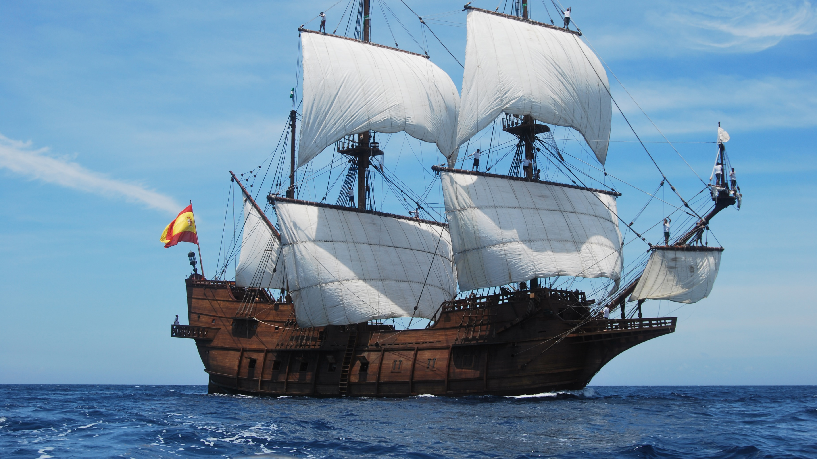
20 years of Mayhem Celebration
Krewe of Andres de Pez

Slide 2
Roll Call
January

Slide 3
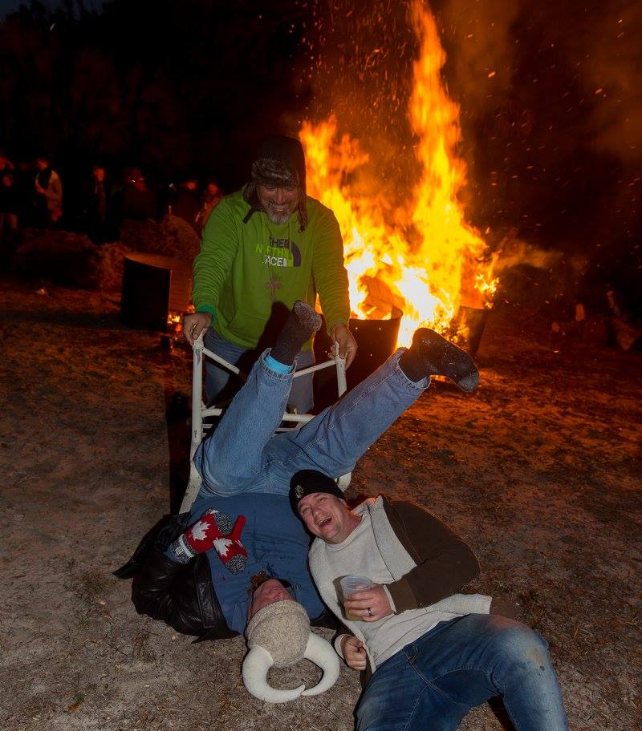
Roll call:
Firework show
Cost: $1000

Slide 4
Krewe Ball
February

Slide 5
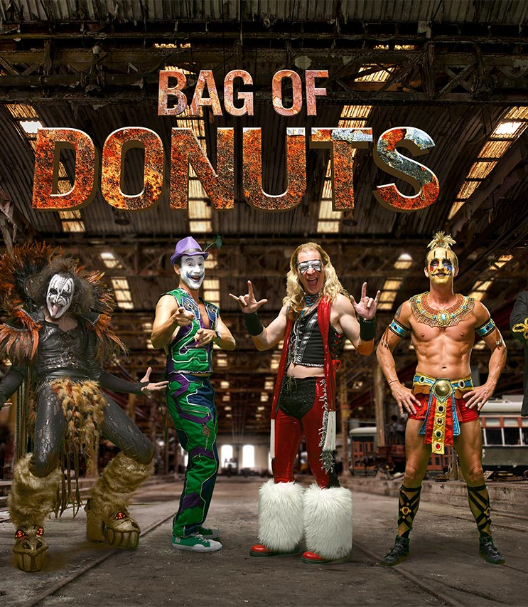
The entertainment

Slide 6
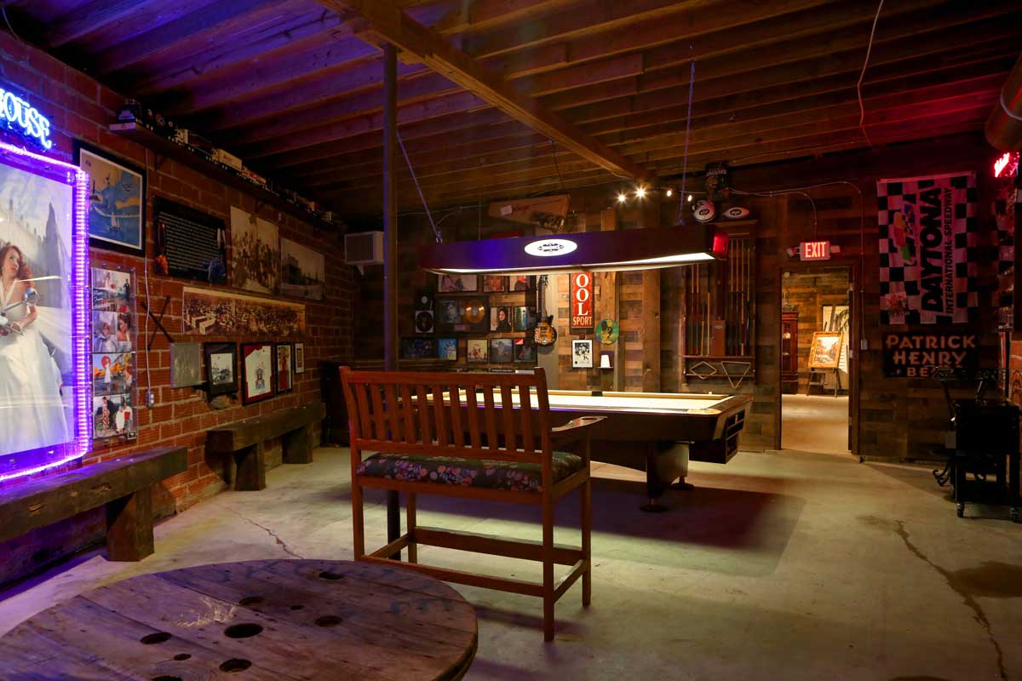
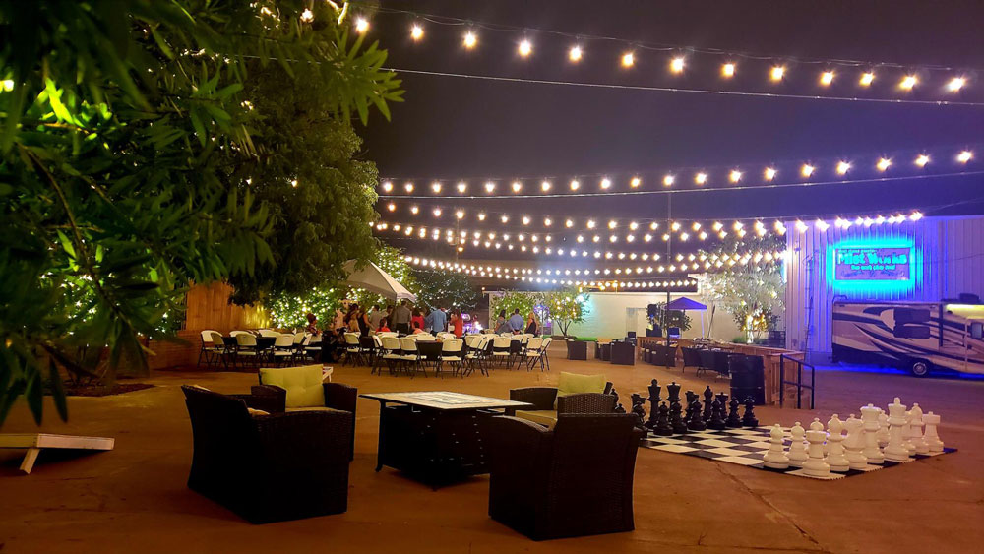
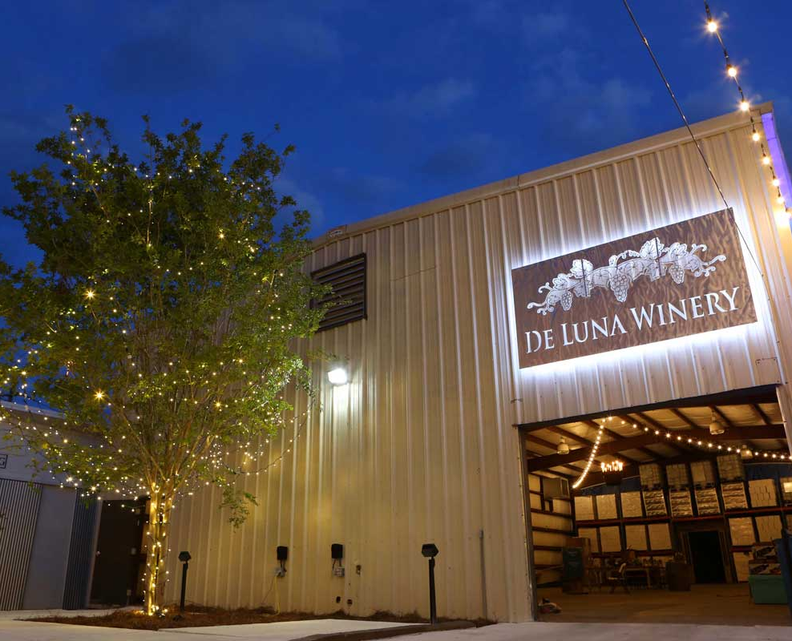
The Venue:
Cigar Patio
Bourbon Bar
More food
Bigger Band
20TH celebration allowing old members to come back for one night of memories- $50 a head for old members plus $50 for their dates
Cost: $6,050

Slide 7
McGuire's Run
March

Slide 8
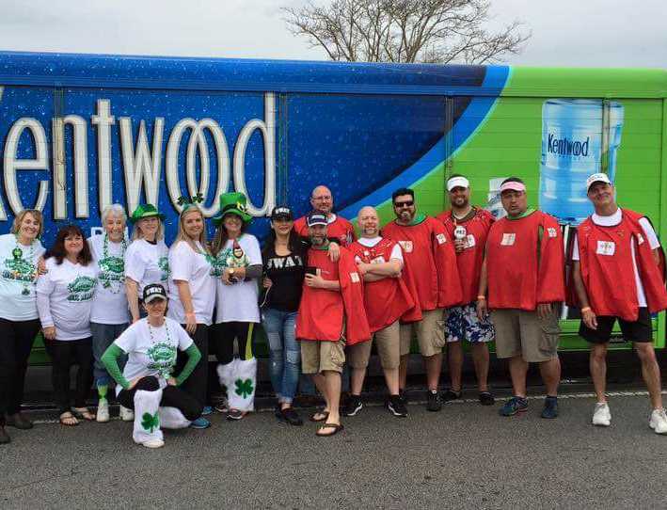
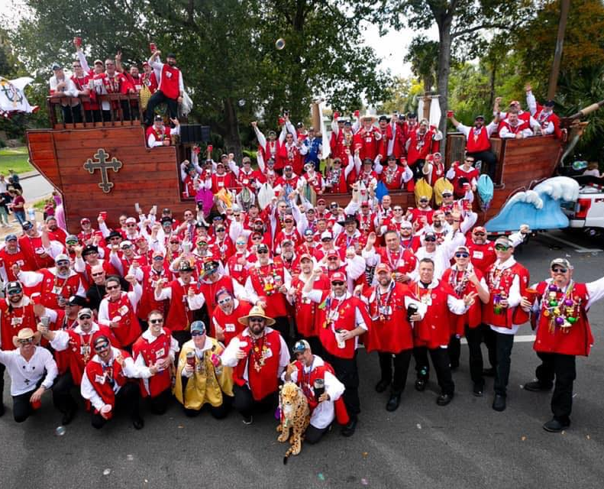
Water station:
Bring new float, along with a keg and party at our De Pez water station.
COST: $150

Slide 9
Bowling Charity Event
April

Slide 10
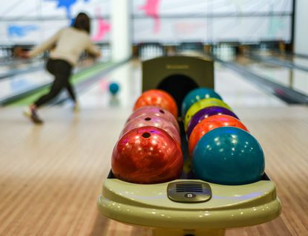
Charity bowling event:
Cordova Lanes
Benefiting Big Brothers Big Sisters of Northwest Florida
Partnering with the Hip Huggers
$1500 sponsorship from ESC
COST: $1500 (covered by ESC)

Slide 11
The Retreat
July

Slide 12
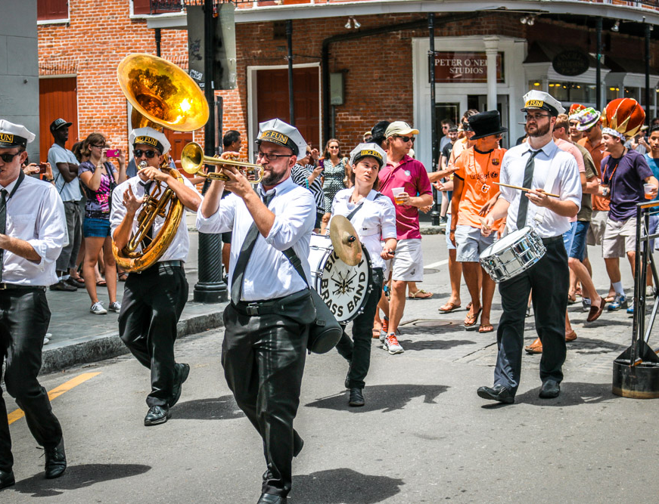
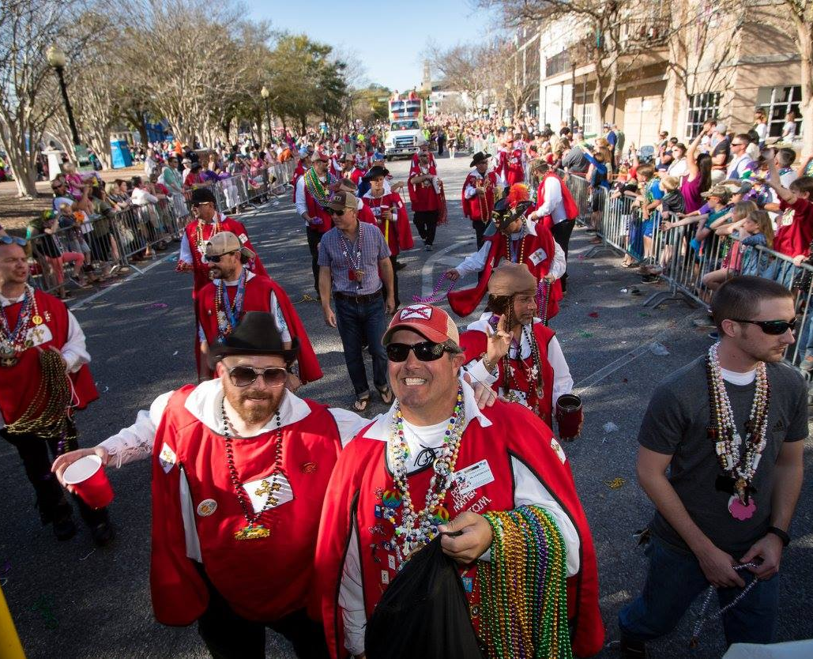
New Orleans Retreat:
First ever De Pez Second Line
10 blocks of Bourbon Street
Wearing tabards down Bourbon street while throwing beads to the crowds
The ONLY parade in town!!!!
Lunch at ACME before
COST: $1900
covered by happy hour budget

Slide 13
Blue Wahoo’s
August
COST: $850

Slide 14
Biloxi Trip
Renting a bus
Koozie
Keg for the bus
Free play
Gamble on college football
sept

Slide 15
Masquerade Ball
September
Open to the public
Goal is to break even
Friends and family can buy tickets
Cost: $7200

Slide 16
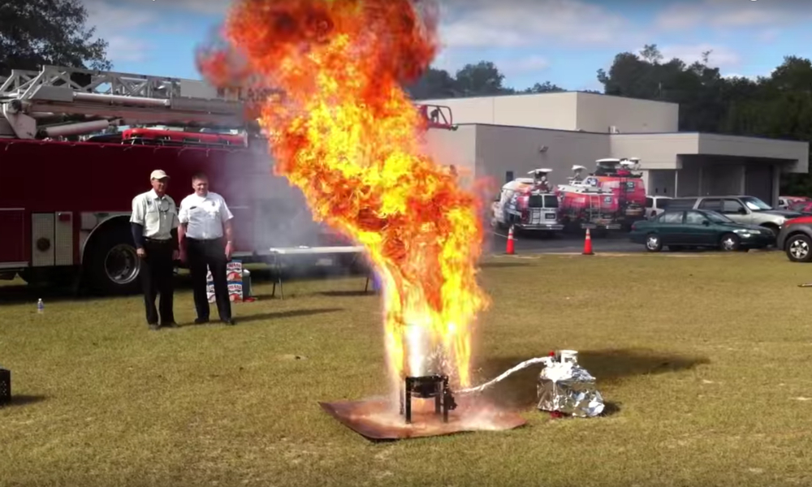
Turkey Fry
Wisteria
We’ll fry your turkey
Cost: $300

Slide 17
Roll Call- $1,000
Krewe Ball- $6050
McGuire's Run- $150 (happy hour budget)
Bowling Tournament- $1500 (covered by ESC sponsorship)
2nd Line NOLA- $1900 (paid by happy hour budget)
New 20th ann. Sails for float- $250 (sig. budget )
Blue Wahoo’s game- $850
Masquerade Ball- $7,200
Biloxi- TBA
Turkey fry- $300 (fiscal 2020-2021 happy hour budget)
TOTAL: $7900
Reminder- We will be selling ticket to old krewe members for the ball and the general public for masquerade ball so actual budget should be less. This is worst case scenario.

